Slide 1
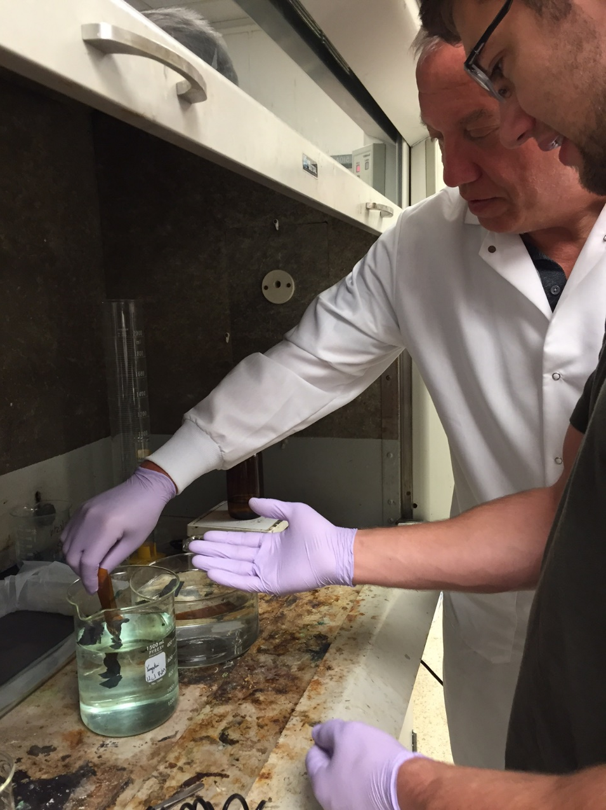
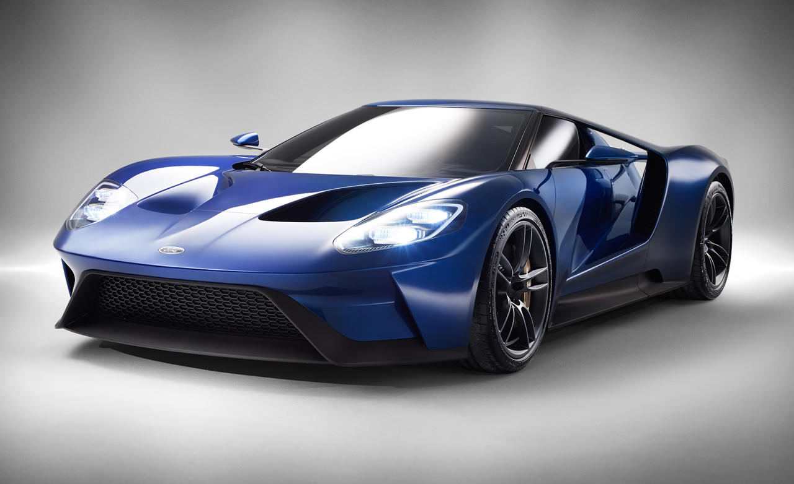
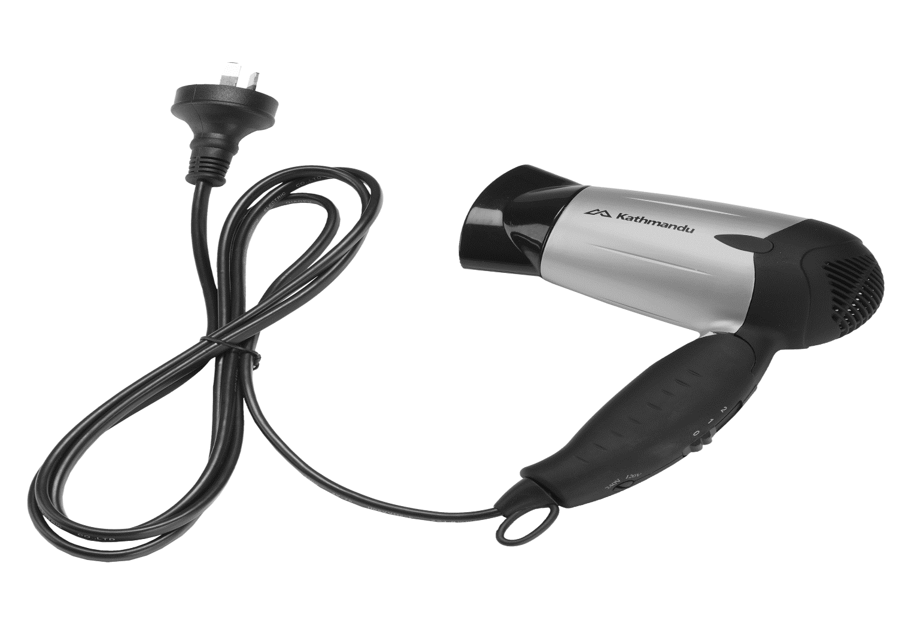
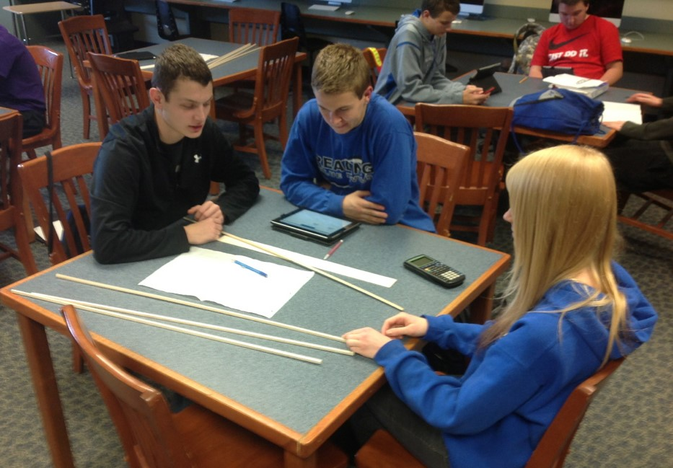
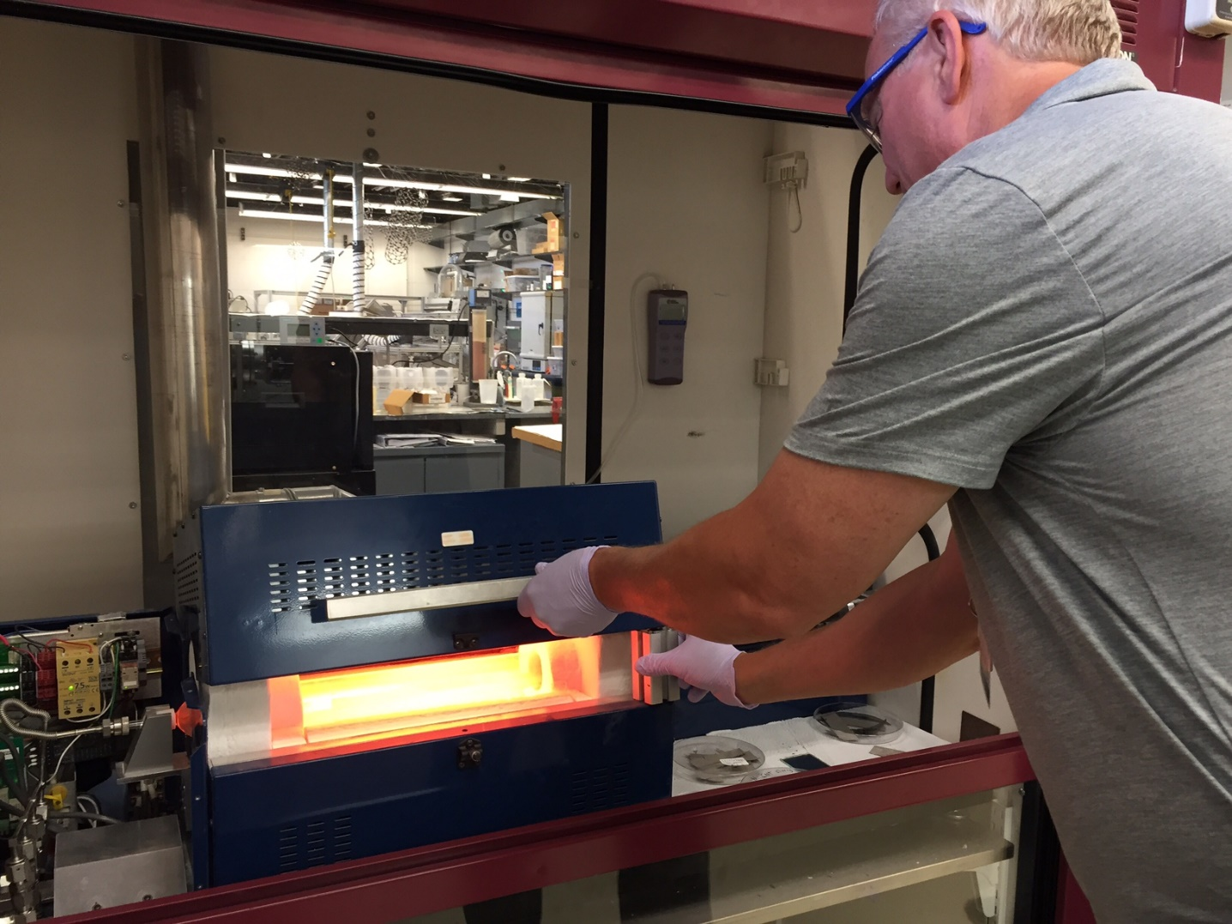
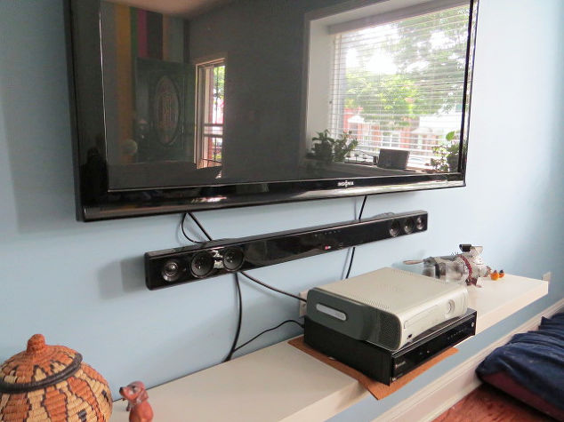
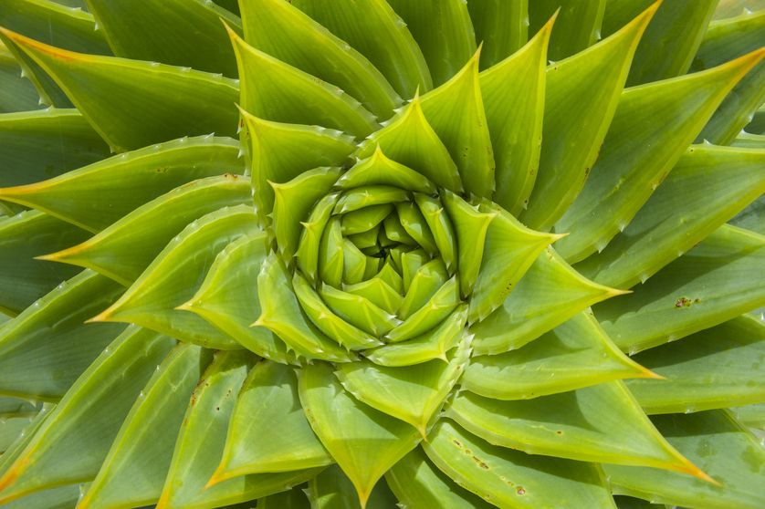
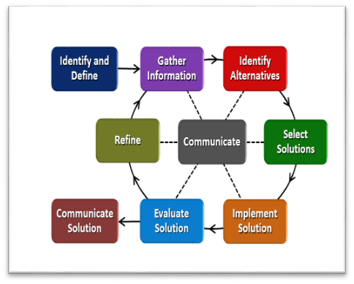
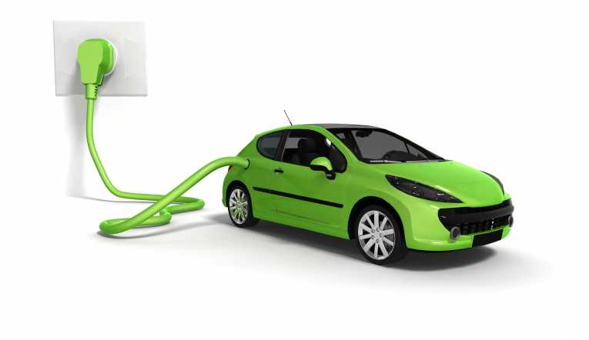
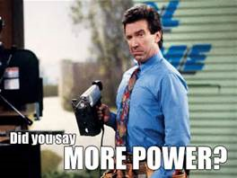
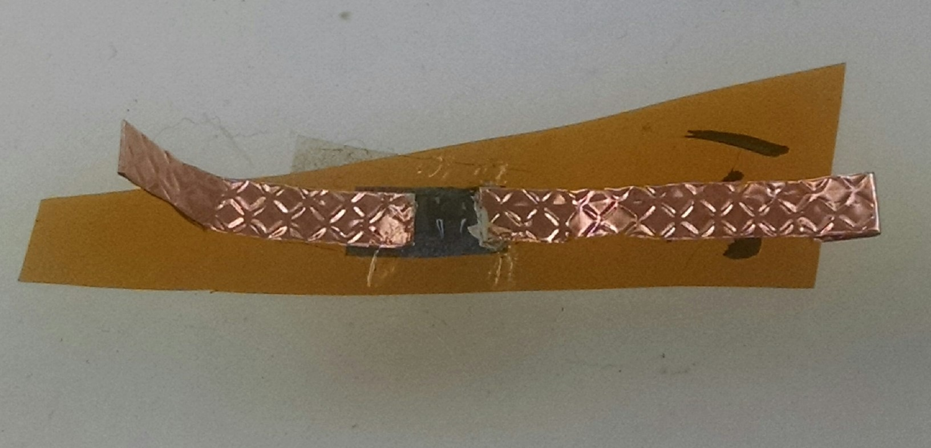
Energy, What is it Good For? Mike Day Reading HS, Mathematics
RET is funded by the National Science Foundation, grant # EEC-1404766
Summer Research:
Manufacture 3-D Graphene Micro-supercapacitor
Improve the Performance of the Micro-supercapacitor
Challenge Based Learning Provides:
Students opportunities to solve problems that have multiple solutions
Solutions to problems using 21st century skills
The opportunity for students to work in teams
Big Idea: Energy Driven Devices
Starting the Research
www.caranddriver.com
www.Kathmandu.com.au
Process for Making Micro-supercapacitor Using Graphene:
Synthesize the Graphene
www.hometalk.com
www.mnn.com
Chemical Vapor Deposition
Engineering Design Process:
The Hook: Are you Still Tied Up?
Characterize the Graphene
SEM Analysis
Manufacture Micro-supercapacitor
Test Micro-supercapacitor
www.earthtimes.org
Final Micro-supercapacitor
www.solvencyiinews.com

